Slide 1

Course name: Computer fundamentals and office applications topic: Students result sheet Presented To: Md Mahbub E Noor,Ast Professor,Dept. of Computer Science & Engineering Presented by:Shamsad Tahani (19PHY030)

Slide 2
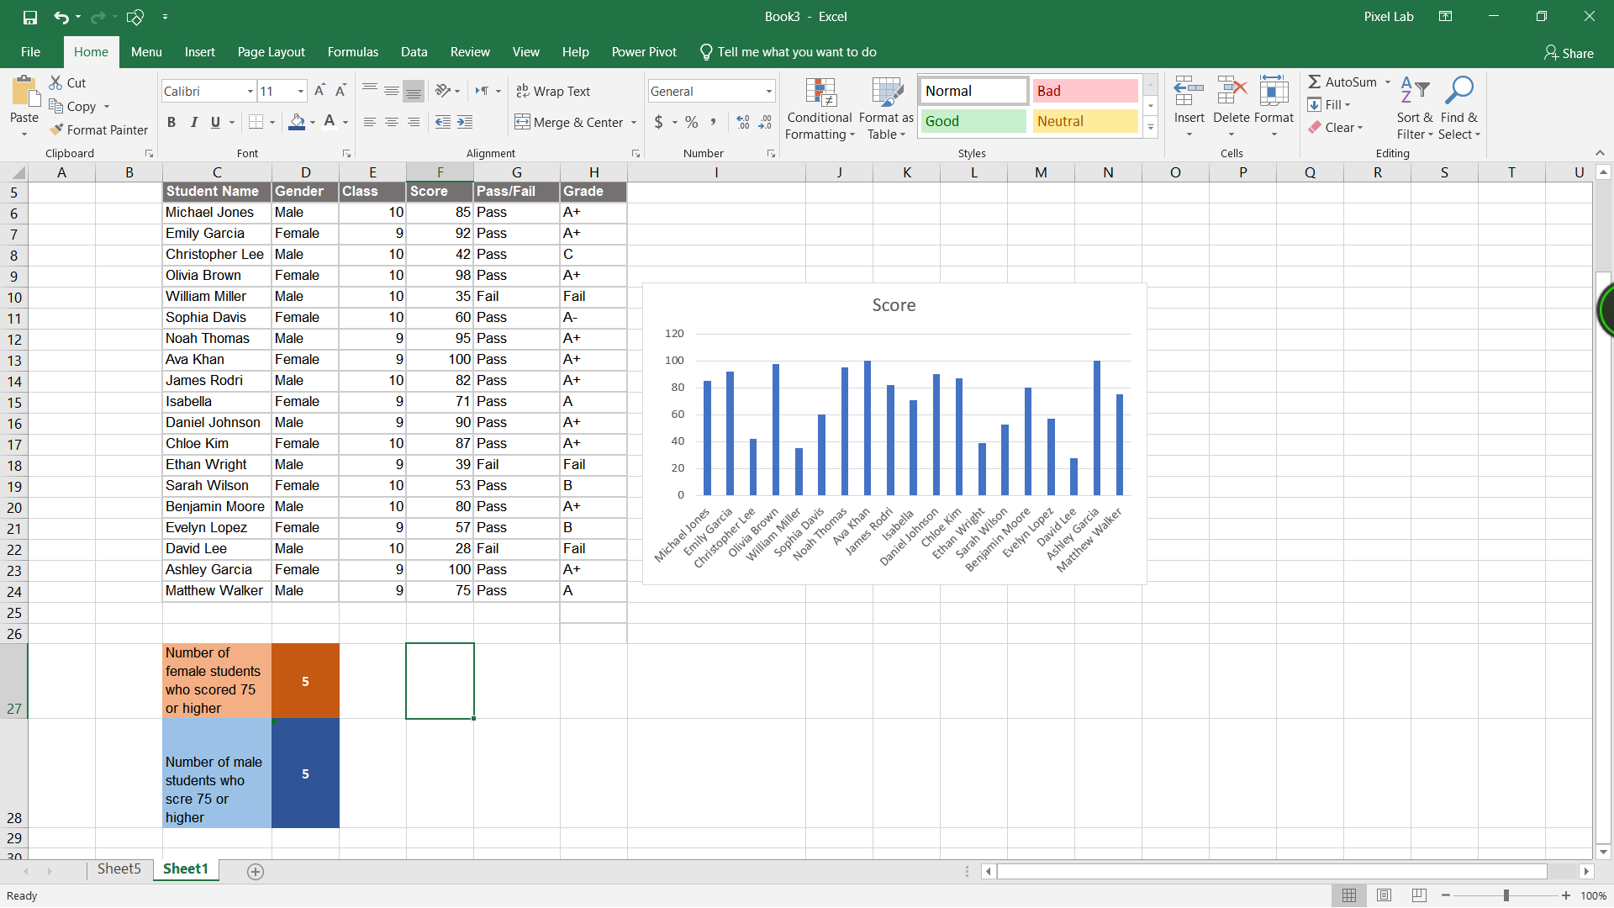
STUDENT RESULT SHEET

Slide 3
●The grade column is created using this formula:
=IF(F6>=80,"A+",IF(F6>=70,"A",IF(F6>=60,"A-",IF(F6>=50,"B",IF(F6>=40,"C","Fail")))))
● the number of female students who scored 75 or higher is counted using this formula:
=COUNTIFS(D6:D24, "Female", F6:F24, ">=75")

Slide 4
Here’s a step-by-step breakdown of formula COUNTIFS:
1. COUNTIFS function: Used to count the number of cells that meet multiple criteria.
2. D6:D24, "Female": The first criteria range and condition, counting cells in column D that contain “Female”.
3. F6:F24, ">=75": The second criteria range and condition, counting cells in column F that are greater than or equal to 75.
=COUNTIFS(D6:D24, "Female", F6:F24, ">=75")
This example assumes the data ranges from row 2 to row 100. Adjusted the range as needed based on the data size.

Slide 5
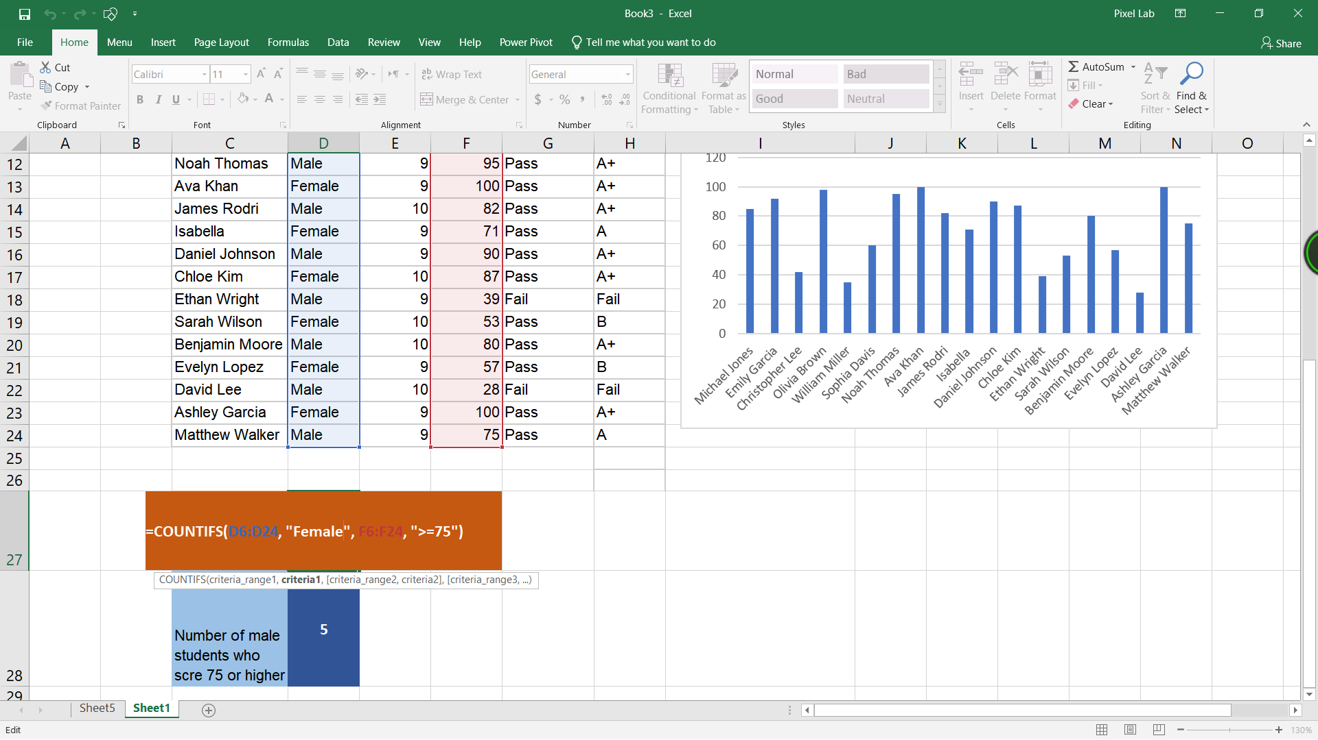
USING FORMULA

Slide 6
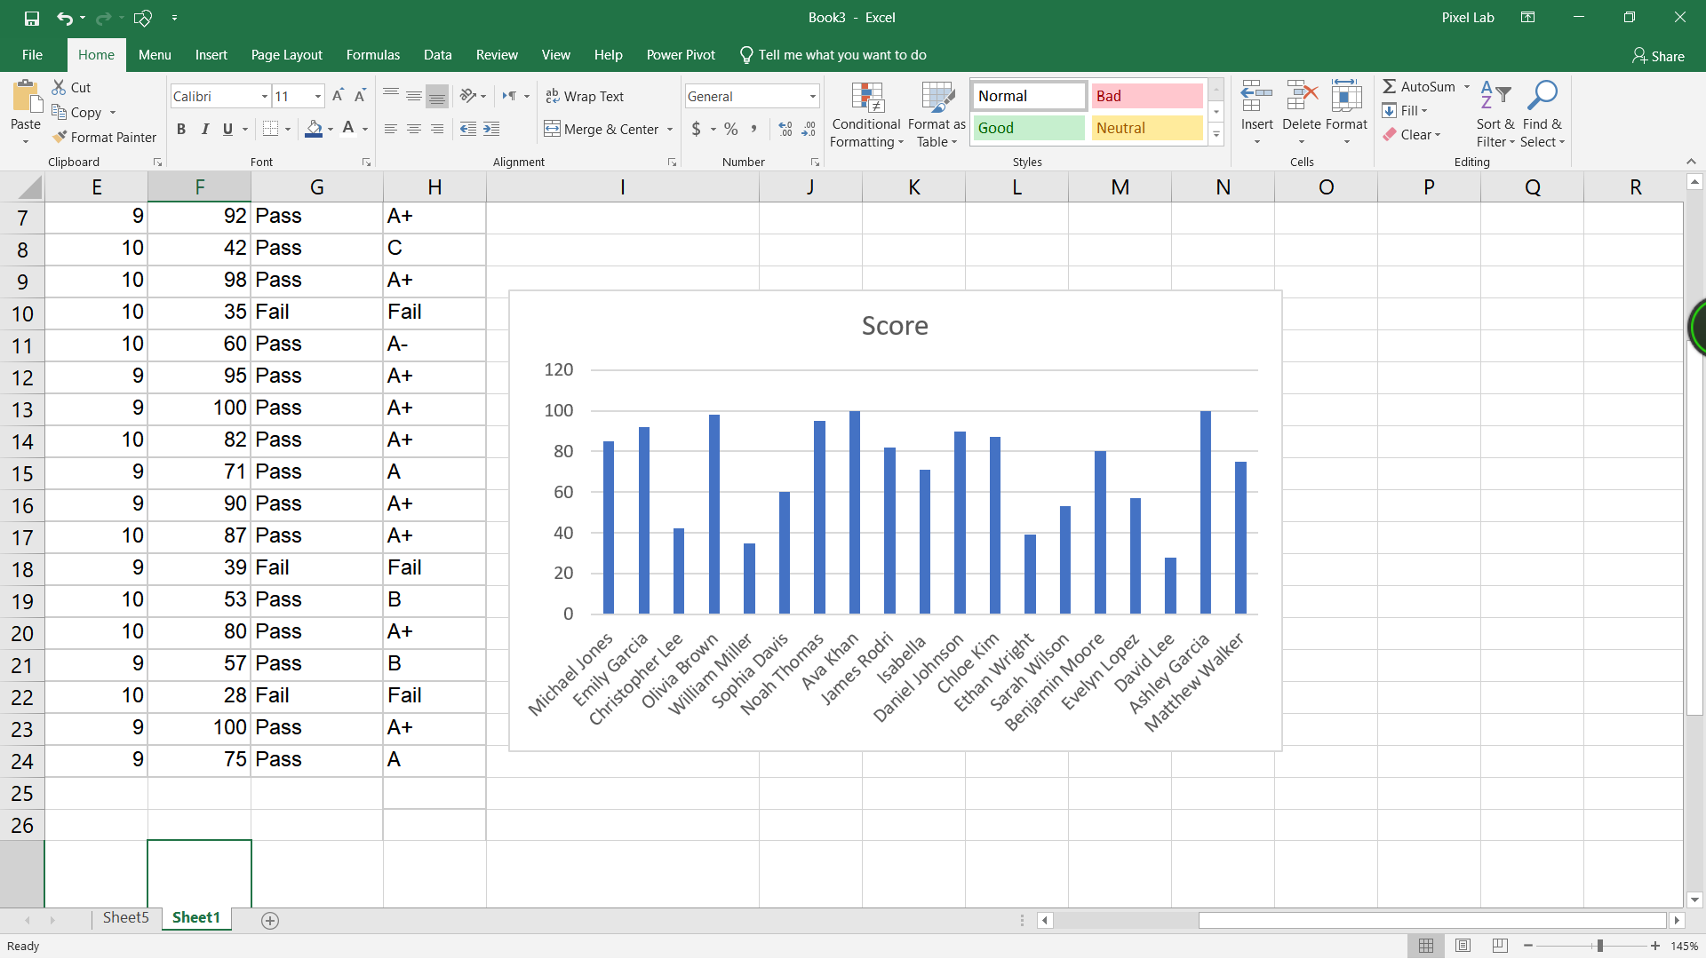
Column Chart

Slide 7
THE END

